Slide 1
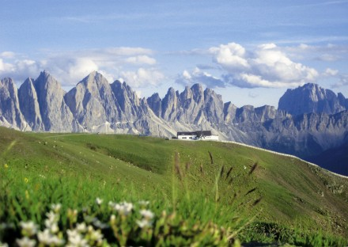
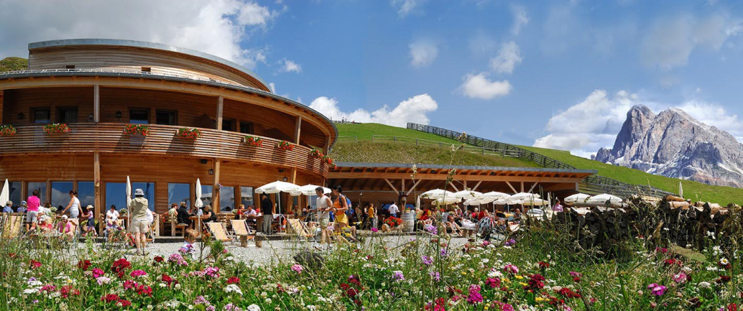
CSAMA Social Programme
Wednesday 14th June 2017
Mount Plose
RossAlm Refuge

Slide 2
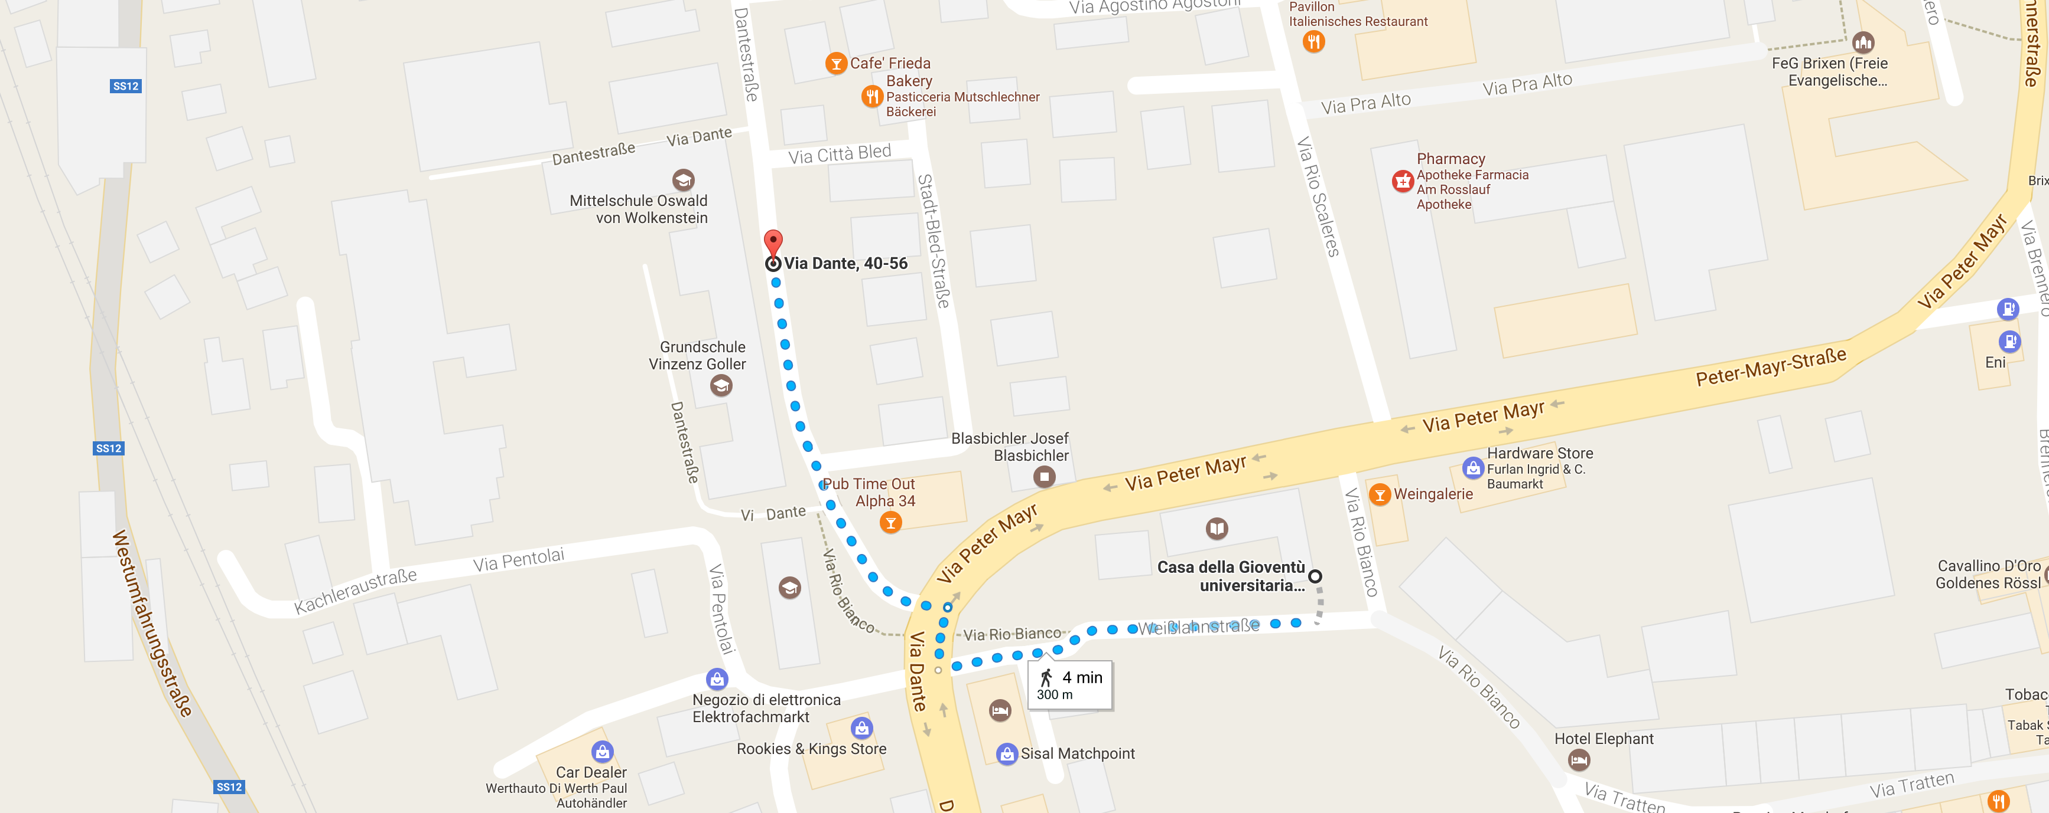
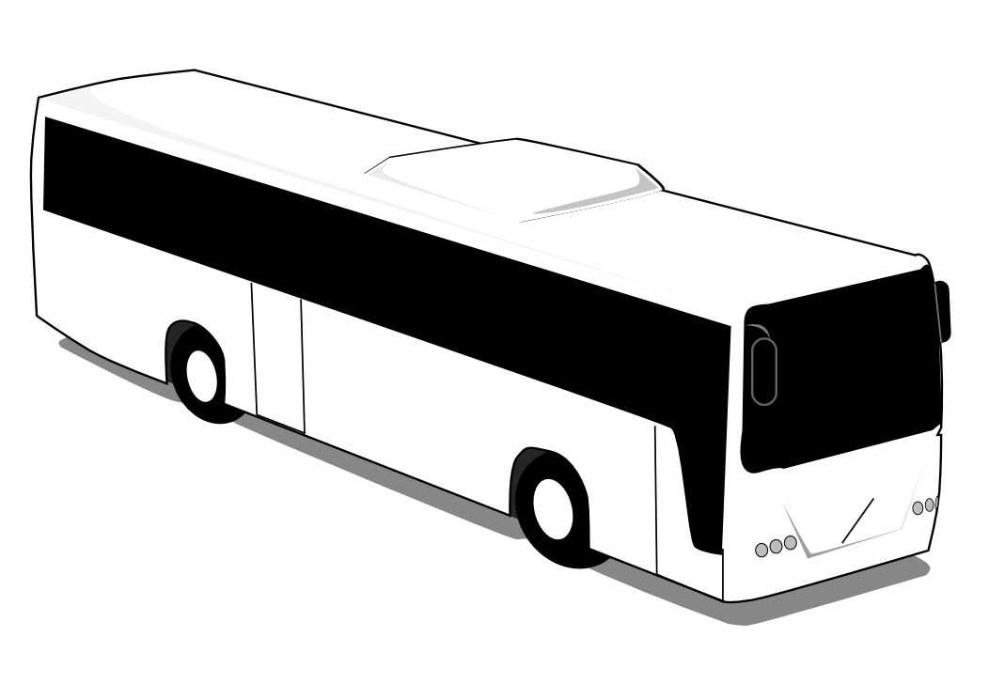
CSAMA Social Programme – Timeline
2:55 pm We meet at here (courtyard of the lecture facilities) and walk 2 min to the bus waiting for us at bus stop Via Dante.
Please take the underpass to cross “Via Peter Mayr.”

Slide 3
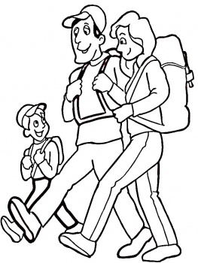
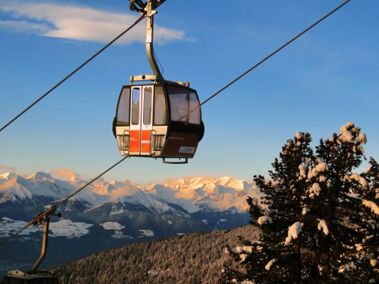
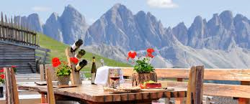
CSAMA Social Programme – Timeline
3:00 pm The bus leaves towards the cable car station in St. Andrä
3:30 pm Cable car takes us up, near peak of Mount Plose, in about 30 min. Altitude 2050 m.
45-60 min Option a.) Gentle hike to RossAlm, alt. 2200m
120 min Option b.) Tougher hike via peak (2560m, steep)
6:00 pm Dinner at RossAlm.
8:00 pm Time to leave! Walk back to Kreuztal parking lot.
9:00 pm The bus takes us back to Brixen (~60min)

Slide 4
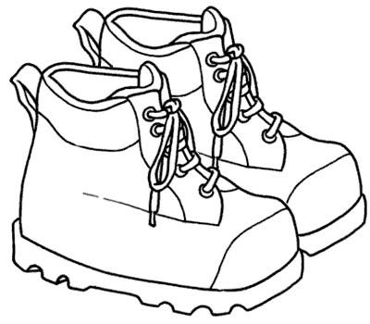
Bring:
Solid footwear (hiking shoes or boots)
Rain proof jacket & warm sweater / fleece (high alpine; risk of thunderstorm)
Please note: If you will not attend, please let us know at the latest by Monday 12th via email to simone.bell@embl.de

